Slide 1
Fafsa Completion Portal
URL: fafsa.ache.edu

Slide 2
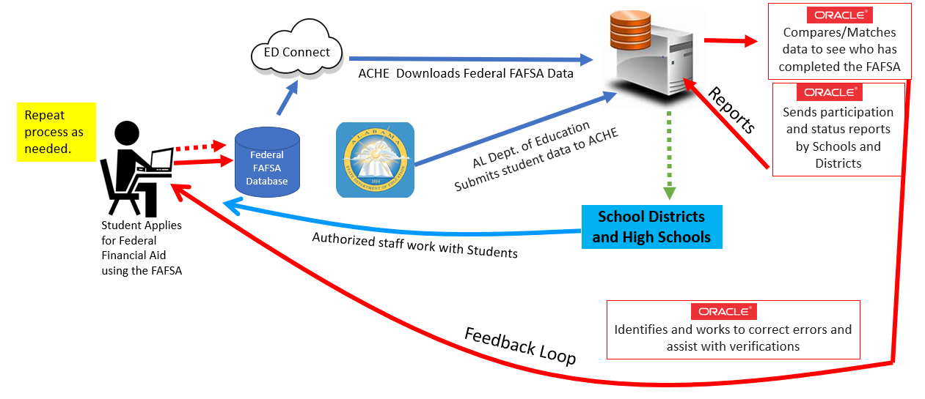
Process Flow Diagram
Process Flow Diagram
Continue process as needed.
ACHE
compares/matches data using Colorado-developed software and produces a new searchable database of Alabama high school students who have submitted FAFSA applications.
Connect EDU
ACHE downloads Federal FAFSA data.
Federal FAFSA Database
AL State Dept of Education (ALSDE)
submits student data to ACHE.
School Districts
Participating Districts access the database to view customizable reports on the schools in their districts.
Student applies for Federal financial aid using a FAFSA.
Authorized staff work with students that have
an incomplete application or have not applied.
High schools in participating districts access the database to view customizable reports on their school and the students in their school.
High Schools

Slide 3
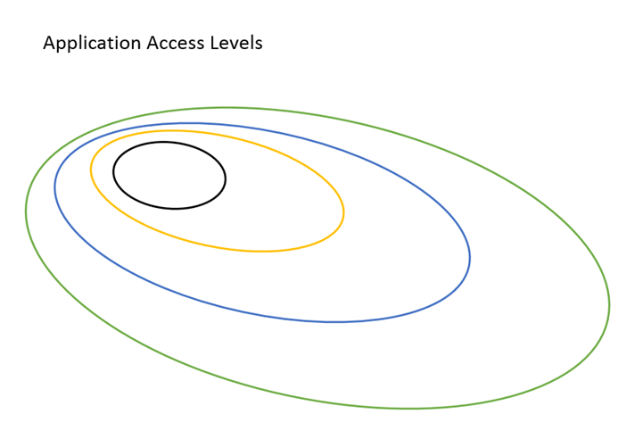
FAFSA Website- User Circles & Access
Public Access
Approved Users
Local Access Managers (LAM)
ACHE Staff
Notes:
Public Access
Summary
Resources
Approved Users (“Data Custodians”
Details
Local Access Managers (LAM)
Manage Users
Load Users
Load User Permissions
ACHE Staff
Manage Data
Load Schools, ISIR, Students
Manage Resources
Manage Statistics

Slide 4
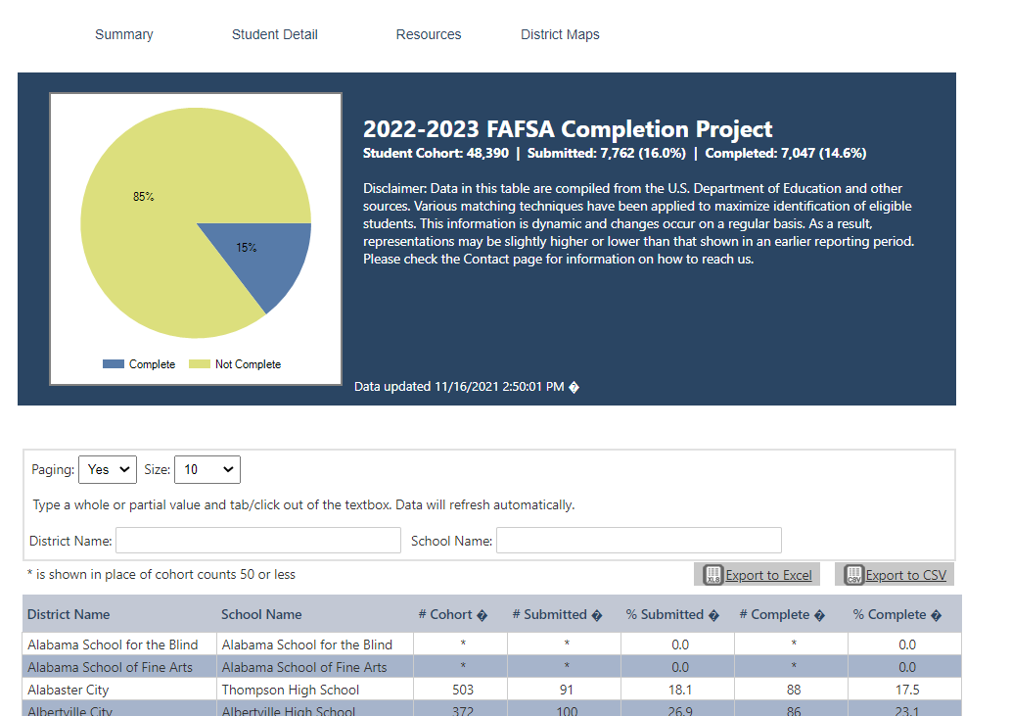
Public Access / View
URL: fafsa.ache.edu
The general public can see completion rates for districts
and schools within districts.
But, the public cannot see
student level data.
Search by district and/or school
Districts are alphabetized.
Schools within a district are alphabetized.

Slide 5
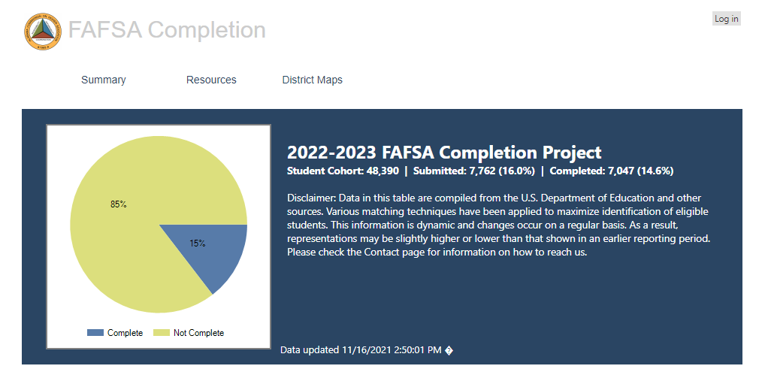
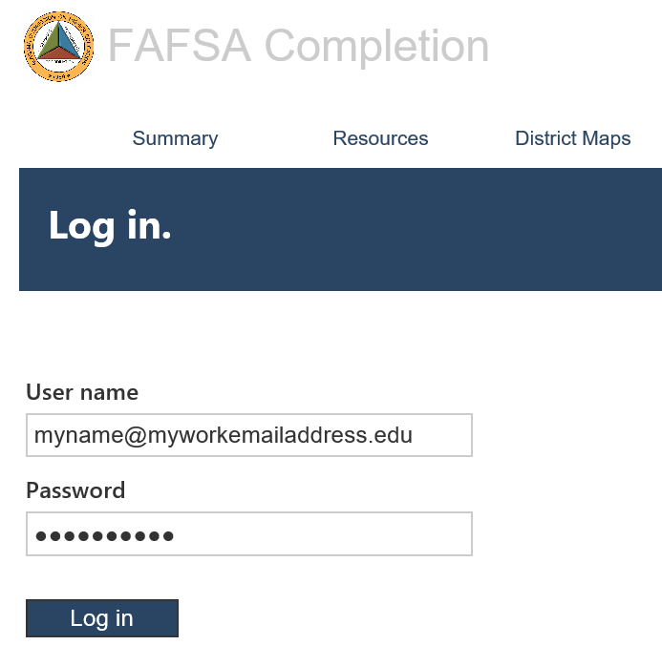
How to log In & Access Student detail
LOG IN (STEPS 1 & 2)
LOG IN (STEP 3)
Steps to Log In
In your browser type, fafsa.ache.edu
In the upper right corner, click “Log in”.
Enter your “User Name” and “Password.” Then click the “Log in” button.
On the resulting page, scroll over Student Detail, and click “2022-2023”

Slide 6
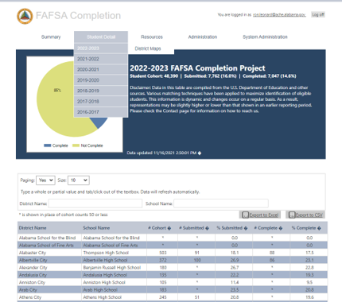
Student Detail Page
From the home page, scroll over “Student Detail”
and then click
“2022-2023”
Notes:
Update screenshot to show Student Detail tab

Slide 7
Student Detail District Name + School Name Search
Sample Search: In the District Name box, type “Mobile” and in the School Name box, type “Mary” for Mary G Montgomery High School.
Important Notes:
When searching by school name, use the first word of the name.
In this example both the students’ first name and last name have been concealed for privacy. Names are alphabetized by last name then first name.
Pay particular attention to the columns with

Slide 8
Student DetaiL District Name + School Name + Fafsa Status search
Sample Search: This example includes the previous search terms, and in the FAFSA Status section, we selected “Complete” from the dropdown menu.
Important Notes:
One caveat: if you do a FAFSA Status search by “Incomplete” that does not include all error fields. For each type of error, search by its error status, for example “Parent Signature,” which means the parent signature is missing.
Notes:
Update screenshot

Slide 9
Current Rankings
Notes:
Update with current rankings

Slide 10
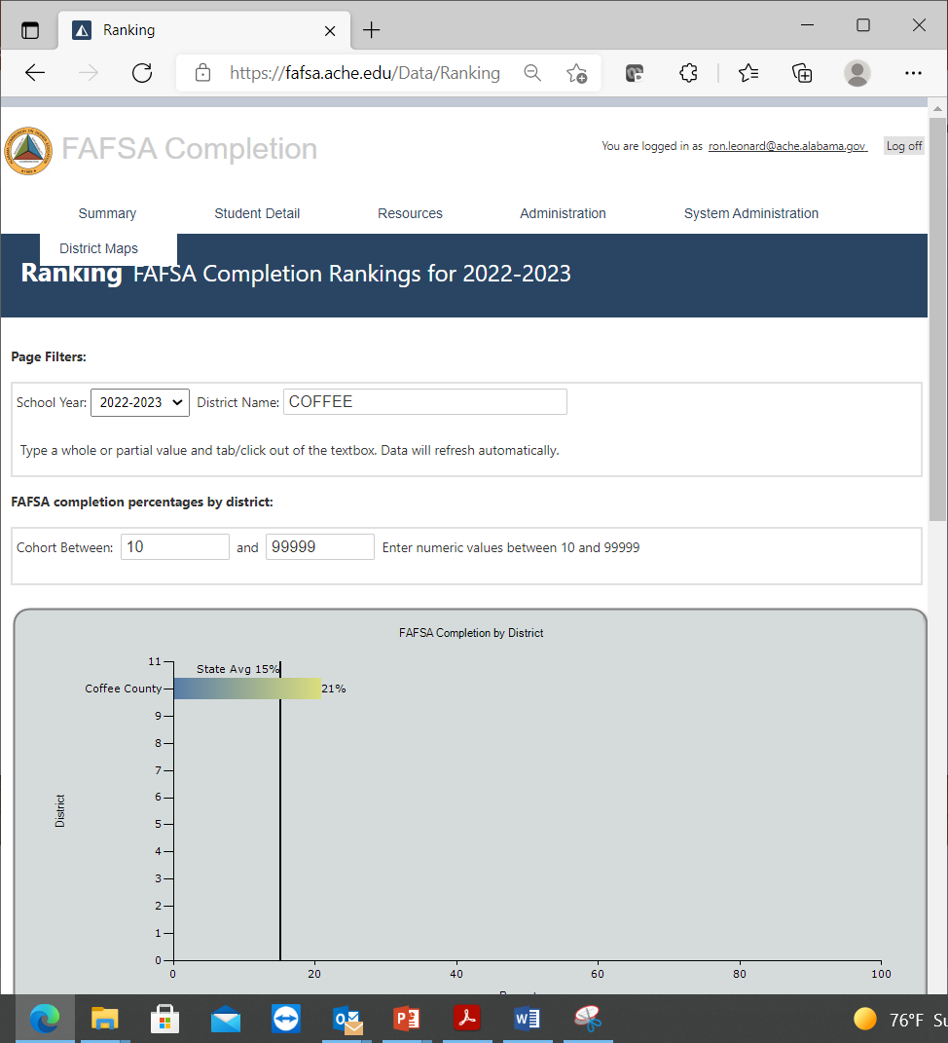
Current Rankings
District Name Search: “Coffee”
Shows the district’s rate and the state’s rate.

Slide 11
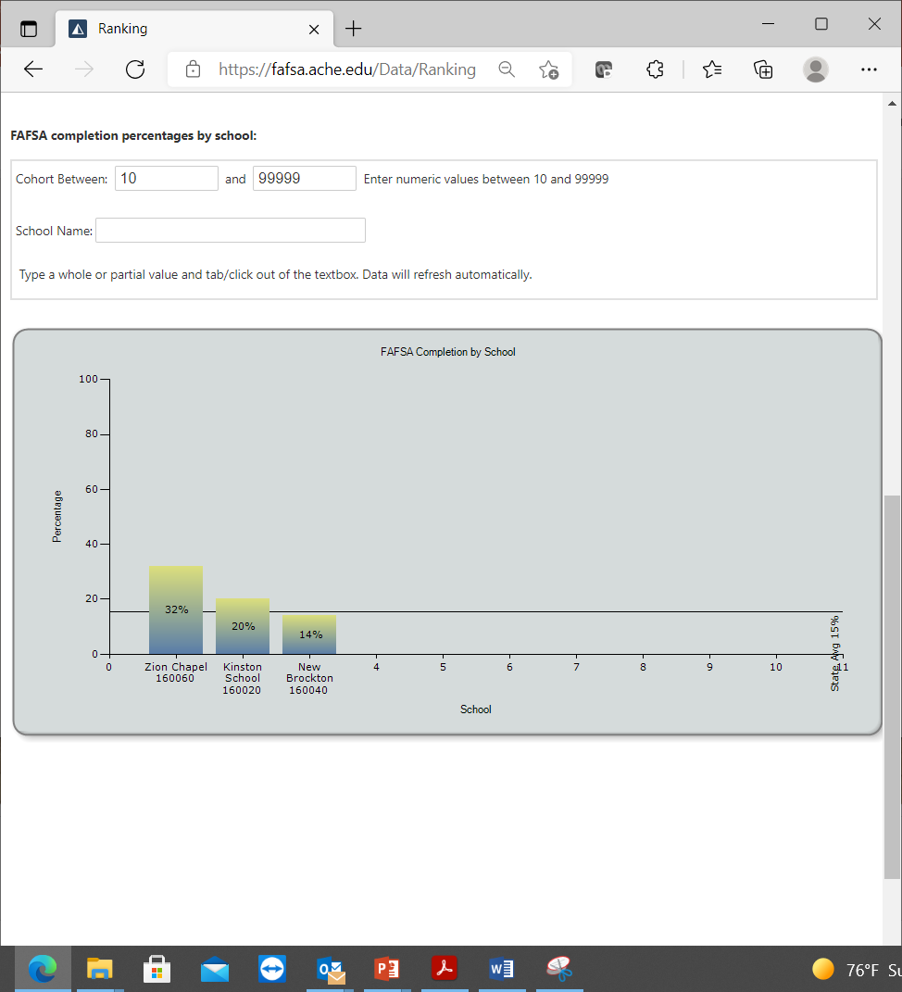
Current Rankings
Scroll down the page to compare up to 10 schools within the district.
Additional schools can be searched for using the “School Name”
Search.

Slide 12
Alabama’s Completion Rate

Slide 13
FAFSA COMPLETION IN ALABAMA
#28
ALABAMA IS
IN FAFSA COMPLETION
AROUND THE COUNTRY

Slide 14
Important information about the portal
Updated weekly for most of the school year.
All personally-identifying information from USDE removed and resulting database accessible by authorized users is stored on separate secure server.
Finds the first error reported for any FAFSA application and reports that. Other errors may exist.
When searching by “FAFSA Status,” the “No-Match” refers to students who haven’t done anything at all.

Slide 15
Important Notes About the Portal
Missing Students:
First, compare the student’s SS# on PowerSchool with what’s on FAFSA.
Via email send a password protected Excel file to fafsa@ache.edu with the following fields (school district, school name, student’s last name, student’s first name, date of birth, social security number.)
Contact Ron Leonard (334.242.2211) for more information.
Training: Virtual or on-site training can be provided with ample notice. Contact Ron at fafsa@ache.edu for more information.

Slide 16
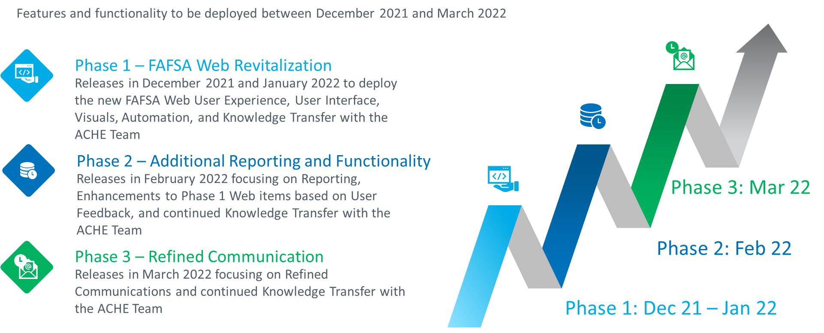
Future Features and Functionality

Slide 17
ACHE Contact
Ron Leonard
fafsa@ache.edu
334.242.2211

Slide 18
The End

