Slide 1
The Importance
of FAFSA

Slide 2
THE IMPORTANCE OF FAFSA
OPPORTUNITIES
FAFSA completion is a key step in pursuing and affording postsecondary education
FAFSA gives students access to the largest source of financial aid to pay for postsecondary degrees and certificates
NCAN: Why Invest in Increasing FAFSA Completion?

Slide 3
THE IMPORTANCE OF FAFSA
OPPORTUNITIES
FAFSA completion is strongly associated with positive increases in postsecondary enrollment, persistence, and attainment
FAFSA completion is associated with narrowing the postsecondary enrollment gap across socioeconomic status
NCAN: Why Invest in Increasing FAFSA Completion?

Slide 4
THE IMPORTANCE OF FAFSA
92%
51%
92% of students who complete FAFSA enroll in postsecondary education the following fall
51% non-completers enroll in postsecondary education the following fall

Slide 5
THE IMPORTANCE OF FAFSA
CHALLENGES
Students who could benefit from financial aid the most are less likely to apply
Many students who are eligible for aid do not apply due to lack of information or misinformation
NCAN: Why Invest in Increasing FAFSA Completion?
NCAN: Survey Data Strengthen Association Between FAFSA Completion and Enrollment

Slide 6
WHY THIS MATTERS
As of 2018, only 45 percent of the Alabama workforce had a high-value credential beyond a high school diploma
(Source: Alabama Workforce Council)
Alabama needs 500,000+ high skilled workers with valuable credentials by 2025
(Source: Alabama Workforce Council)
Notes:
As of 2018, only 45% of the Alabama workforce has a valuable credential beyond a high school diploma
To fulfill labor needs, our state aims to add 500,000 highly-skilled employees to the workforce by 2025 which would raise our postsecondary educational attainment rate from 45% to around 60%

Slide 7
WHY THIS MATTERS
An estimated 57.4% of students in Alabama qualify for a Pell Grant aid of up to $6,495 which can only be accessed through the FAFSA
But every year, students in Alabama miss out on postsecondary pathways when they leave behind millions of dollars in free aid by not completing the FAFSA
To ensure we increase postsecondary educational attainment, we must ensure we increase FAFSA completion

Slide 8
WHY THIS MATTERS
No Pell Grant
No FAFSA
No Low-Interest Federal Student Loan
No Scholarship
More Student Loan Debt

Slide 9
FAFSA #FastFacts
FAFSA determines a student’s eligibility for grants, scholarships, work-study jobs, and loans.

Slide 10
MILLIONS LEFT ON THE TABLE
57.4%
Percent of High School Graduates Qualifying for a Pell Grant
52.8%
Percent of High School Graduates Who Failed to Complete the FAFSA
26,702
Number of High School Graduates Who Failed to Complete the FAFSA
15,327
Number Who Failed to Complete the FAFSA Who Probably Qualified for a Pell Grant
$4,307
Average Pell Grant for an Alabama Student
$66,013,165
Estimated Total Pell Grant Funds Left Unclaimed

Slide 11
Fafsa Completion Portal
URL: fafsa.ache.edu

Slide 12
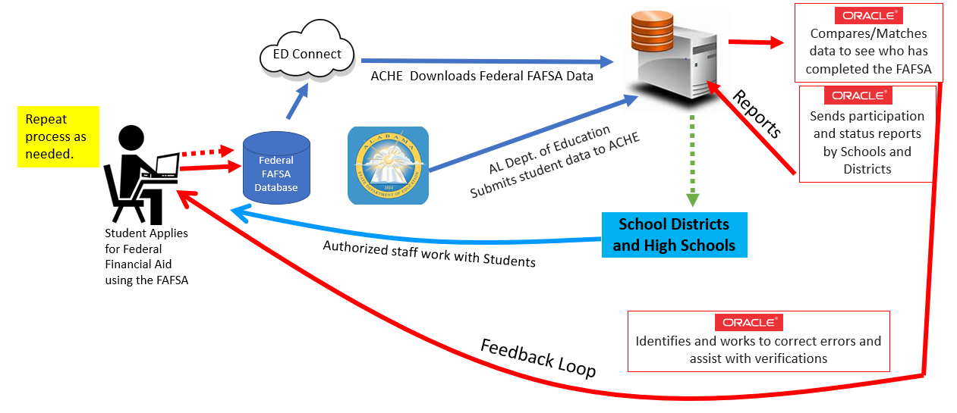
Process Flow Diagram
Process Flow Diagram
Continue process as needed.
ACHE
compares/matches data using Colorado-developed software and produces a new searchable database of Alabama high school students who have submitted FAFSA applications.
Connect EDU
ACHE downloads Federal FAFSA data.
Federal FAFSA Database
AL State Dept of Education (ALSDE)
submits student data to ACHE.
School Districts
Participating Districts access the database to view customizable reports on the schools in their districts.
Student applies for Federal financial aid using a FAFSA.
Authorized staff work with students that have
an incomplete application or have not applied.
High schools in participating districts access the database to view customizable reports on their school and the students in their school.
High Schools

Slide 13
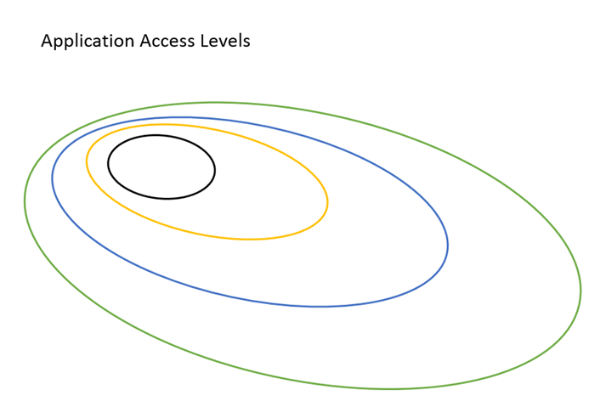
FAFSA Website- User Circles & Access
Public Access
Approved Users
Local Access Managers (LAM)
ACHE Staff
Notes:
Public Access
Summary
Resources
Approved Users (“Data Custodians”
Details
Local Access Managers (LAM)
Manage Users
Load Users
Load User Permissions
ACHE Staff
Manage Data
Load Schools, ISIR, Students
Manage Resources
Manage Statistics

Slide 14
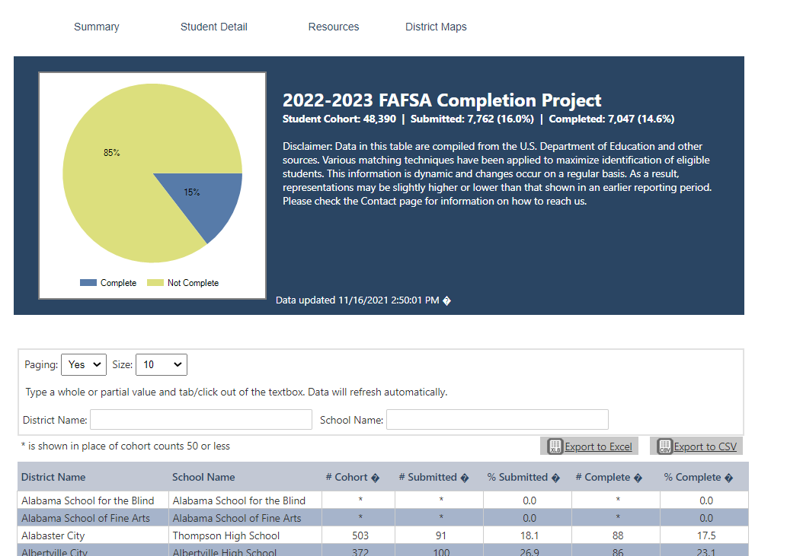
Public Access / View
URL: fafsa.ache.edu
The general public can see completion rates for districts
and schools within districts.
But, the public cannot see
student level data.
Search by district and/or school
Districts are alphabetized.
Schools within a district are alphabetized.

Slide 15
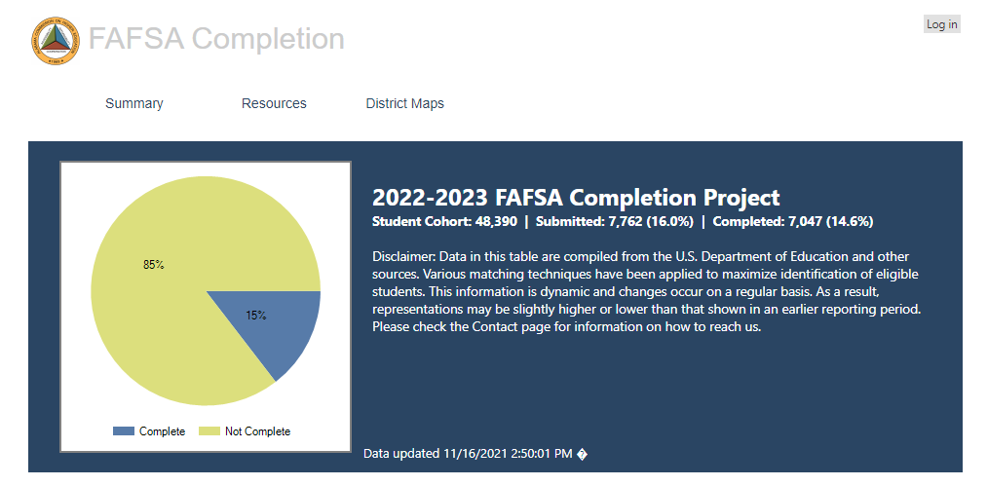
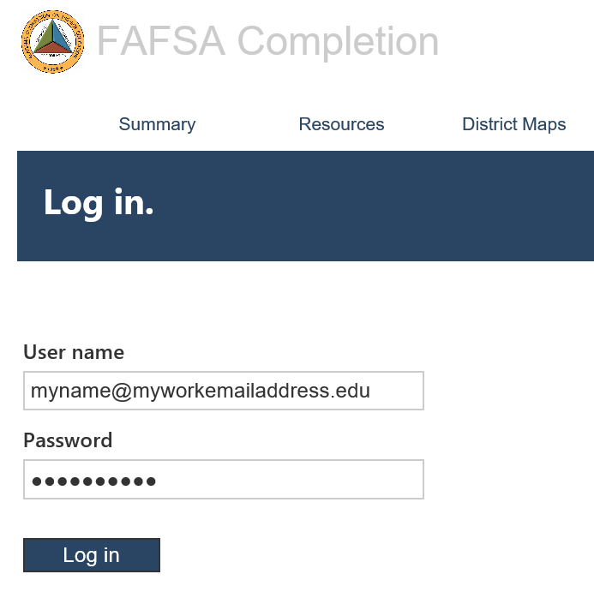
How to log In & Access Student detail
LOG IN (STEPS 1 & 2)
LOG IN (STEP 3)
Steps to Log In
In your browser type, fafsa.ache.edu
In the upper right corner, click “Log in”.
Enter your “User Name” and “Password.” Then click the “Log in” button.
On the resulting page, scroll over Student Detail, and click “2022-2023”

Slide 16
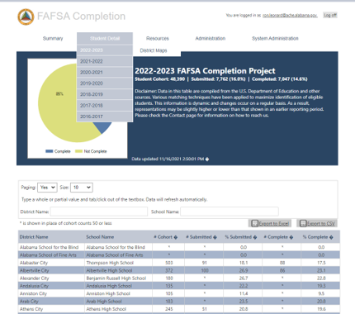
Student Detail Page
From the home page, scroll over “Student Detail”
and then click
“2022-2023”
Notes:
Update screenshot to show Student Detail tab

Slide 17
Student Detail District Name + School Name Search
Sample Search: In the District Name box, type “Mobile” and in the School Name box, type “Mary” for Mary G Montgomery High School.
Important Notes:
When searching by school name, use the first word of the name.
In this example both the students’ first name and last name have been concealed for privacy. Names are alphabetized by last name then first name.
Pay particular attention to the columns with

Slide 18
Student DetaiL District Name + School Name + Fafsa Status search
Sample Search: This example includes the previous search terms, and in the FAFSA Status section, we selected “Complete” from the dropdown menu.
Important Notes:
One caveat: if you do a FAFSA Status search by “Incomplete” that does not include all error fields. For each type of error, search by its error status, for example “Parent Signature,” which means the parent signature is missing.
Notes:
Update screenshot

Slide 19
Current Rankings
Notes:
Update with current rankings

Slide 20
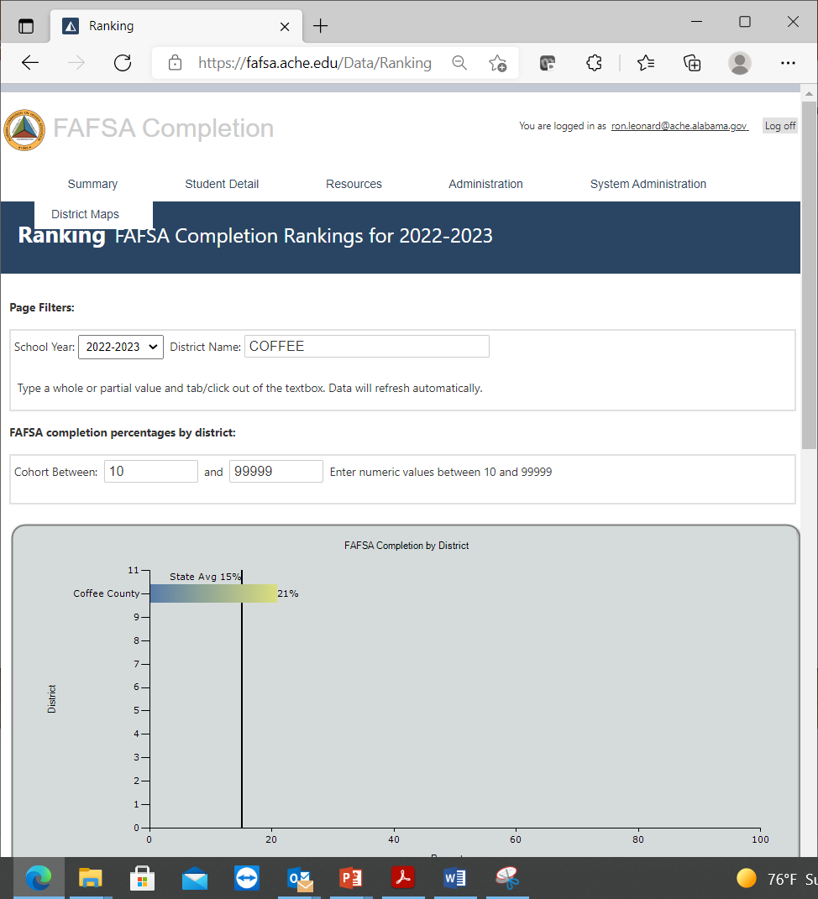
Current Rankings
District Name Search: “Coffee”
Shows the district’s rate and the state’s rate.

Slide 21
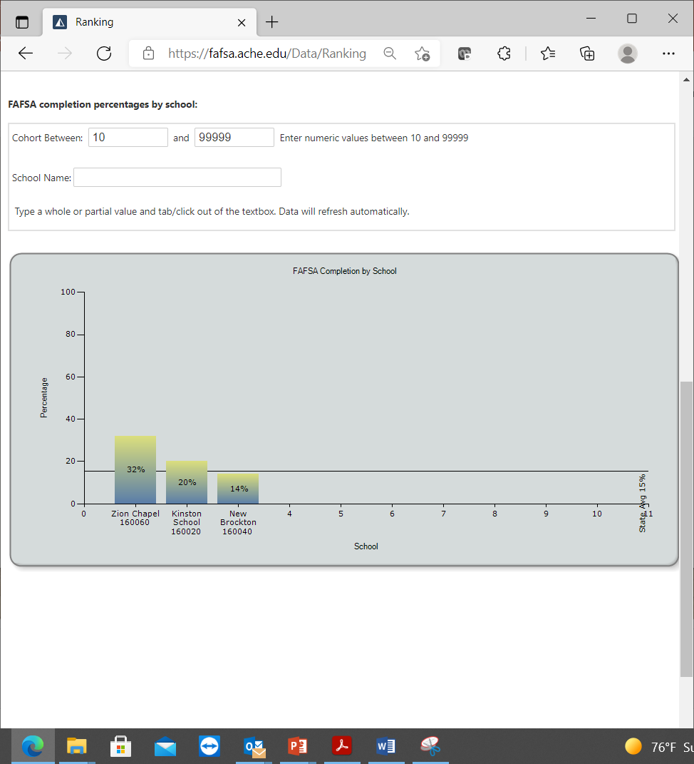
Current Rankings
Scroll down the page to compare up to 10 schools within the district.
Additional schools can be searched for using the “School Name”
Search.

Slide 22
Alabama’s Completion Rate as of Dec. 2, 2021

Slide 23
FAFSA COMPLETION IN ALABAMA
#28
ALABAMA IS
IN FAFSA COMPLETION
AROUND THE COUNTRY

Slide 24
Important information about the portal
Updated weekly for most of the school year.
All personally-identifying information from USDE removed and resulting database accessible by authorized users is stored on separate secure server.
Finds the first error reported for any FAFSA application and reports that. Other errors may exist.
When searching by “FAFSA Status,” the “No-Match” refers to students who haven’t done anything at all.

Slide 25
Important Notes About the Portal
Missing Students:
First, compare the student’s SS# on PowerSchool with what’s on FAFSA.
Via email send a password protected Excel file to fafsa@ache.edu with the following fields (school district, school name, student’s last name, student’s first name, date of birth, social security number.)
Contact Ms. Nikesha Ross (334.353.1159) for more information.
Training: Virtual or on-site training can be provided with ample notice. Contact Ron Leonard (334.242.2211) for more information.

Slide 26
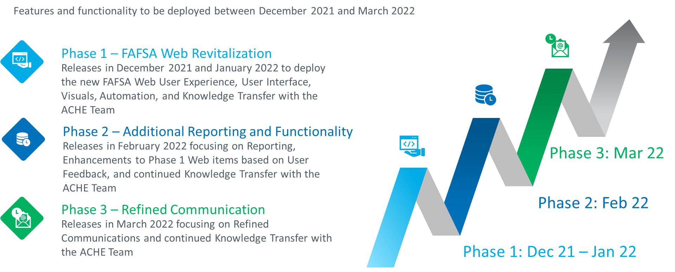
Future Features and Functionality

Slide 27
ACHE Contacts
Ron leonard
Nikesha Ross
Email: fafsa@ache.edu
Phone: 334.242.2211
Email: fafsa@ache.edu
Phone: 334.353.1159

Slide 28
The End

Slide 29
FAFSA Completion Portal
Local Access Manager (LAM) View

Slide 30
How to log In & Access Student detail
LOG IN (STEPS 1 & 2)
LOG IN (STEP 3)
Steps to Log In
The LAM will log in the same way as all other users:
In your browser type, fafsa.ache.edu
In the upper right corner, click “Log in”.
Enter your “User Name” and “Password.” Then click the “Log in” button.

Slide 31
Local access Manager (LAM) View Administrative Functions
The view will look similar to what other end-users see with the addition of the “Administrative”
column.
Scroll over
the column and click “Manager Users”

Slide 32
Local Access Manager (LAM) View Features and Functionality
Once on the Manage Users page, you’ll notice several information icons for how to make changes to accounts.
Directly beneath them is a link to create a new user.
To make changes to an existing user’s account, such as to change the password, click the applicable link.

Slide 33
Local Access Manager (LAM) Create a new User
Once on the create new user page, enter the applicable fields, click the arrow next to “District”, select the school from the resulting list, and be sure to hit “Save” when done.

